Slide 1
Deliverable 3
Swapnil Srivastava, Alex Thropp and Jonas Schulz

Slide 2
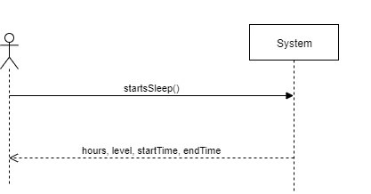
System Sequence Diagram

Slide 3
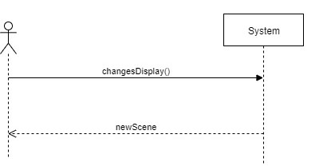
System Sequence Diagram

Slide 4
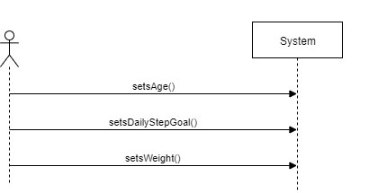
System Sequence Diagram

Slide 5
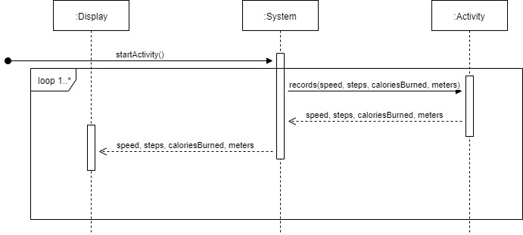
Sequence Diagram

Slide 6
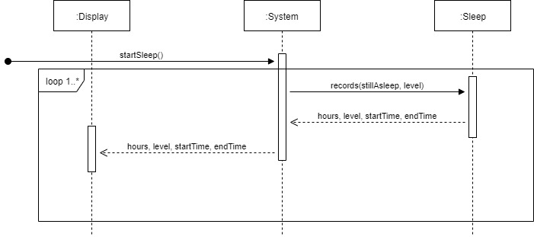
Sequence Diagram

Slide 7
Operation Contracts
Contract: recordSleep()
Operation: startSleep()
Cross References: Use Case 2
Pre-conditions:
System is on
Pedometer active
Gyroscope active
Sleep was detected
Post-conditions:
An Sleep instance sleep was created
sleep was associated with day

Slide 8
Operation Contracts
Contract: recordSleep()
Operation: record (stillAsleep: boolean, level: integer)
Cross References: Use Case 2
Pre-conditions:
An Sleep instance sleep was created
sleep was associated with day
stillAsleep == true
Post-conditions:
sleep.hours became 5 minutes more
sleep.level became level
sleep.startTime became startTime
sleep.endTime became current Time

Slide 9
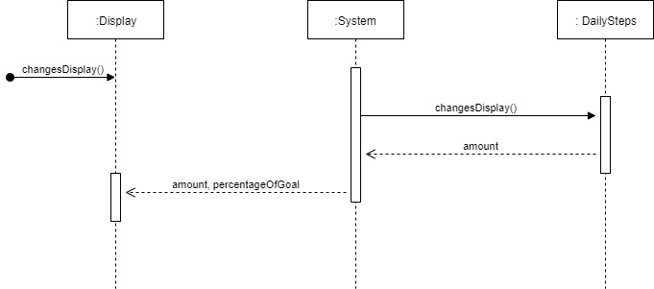
Sequence Diagram

Slide 10
Operation Contracts
Contract: dailyStepsScene
Operation: changesDisplay()
Cross References: Use Case 3
Pre-conditions:
System is on
Former Scene was “home”
User pressed the button
Post-conditions:
Display.scene became “dailySteps”

Slide 11
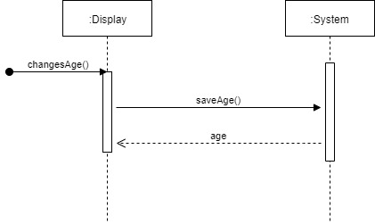
Sequence Diagram

Slide 12
Operation Contracts
Contract: setAge
Operation: setAge (age: integer)
Cross References: Use Case 6
Pre-conditions:
System is on
User accesses age through settings
Post-conditions:
system.age became age

Slide 13
User Interface - First Vision
11: 55PM
09/14/19
Our Initial Vision

Slide 14
User Interface - Updated
Our Current Vision

Slide 15
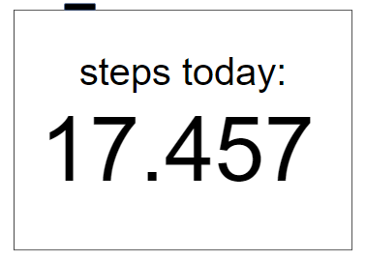
User Interface - First Vision

Slide 16
User Interface - Updated

Slide 17
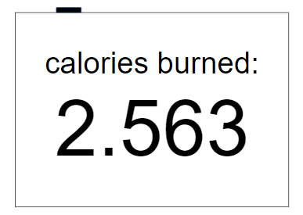
User Interface - First Vision

Slide 18
User Interface - Updated

Slide 19
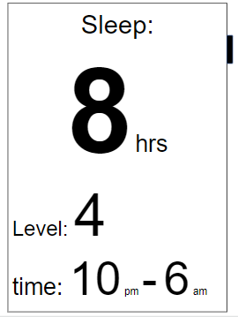
User Interface - First Vision

Slide 20
User Interface - Updated

